Slide 1
A 60GHz up-conversion mixer using asymmetric layout with -41.1dBc LO leakage
Yuki Tsukui, Kenichi Okada
and Akira Matsuzawa
Tokyo Institute of Technology, Japan
Notes:
Thank you for the kind introduction.
I’m Yuki Tsukui from Tokyo Institute of Technology, Japan.
Today, I’d like to talk about a 60GHz up-conversion mixer using asymmetric layout with -41.1dBc LO leakage.

Slide 2
Outline
Background
Mixer topology
Asymmetric layout
Measurement results
Conclusion
Notes:
This is the outline of my presentation.
First of all, I’ll talk about a 60GHz wireless communication.
Next, I’ll talk about mixer topology and new layout method to decrease LO leakage and RF-LO isolation.
Next, I’ll talk about measurement results of the mixer using asymmetric layout.
Finally, I’ll conclude the presentation.

Slide 3
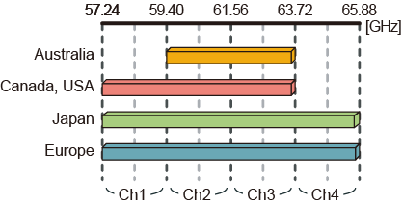
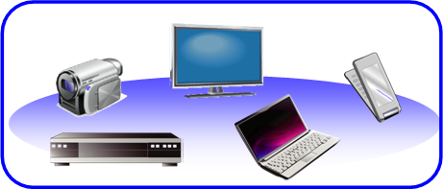
Background
Characterization of 60GHz
☹ Attenuation is large.
☺ Wide bandwidth can be used without license.
Suitable for short range and very high-speed wireless communication
High-speed
file/data transfer
IEEE 802.15.3c
Bandwidth 2.16GHz × 4ch
QPSK ⇒ 3.5Gbps × 4ch
16QAM ⇒ 7.0Gbps × 4ch
Notes:
Now, 60GHz wireless communication has become a very important research target.
As the characterization of 60GHz, wave attenuation is large.
But, as shown in this figure, wide bandwidth can be used without license in many countries.
So, 60GHz band is suitable for short range and very high-speed wireless communication.
According to IEEE 802.15.3c, 9GHz frequency bandwidth is separated into 4 channels, and each channel has 2.16GHz of bandwidth.
By using this 2.16GHz bandwidth, we can realize 3.5Gbps in QPSK modulation and 7.0Gbps in 16QAM.
This is a very big motivation to use 60GHz carrier frequency.

Slide 4
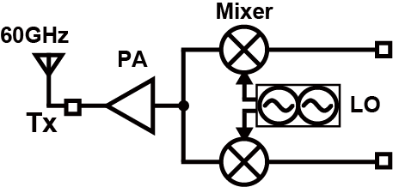
Object
RF-LO isolation
LO leakage
Mixer
  LO leakage ⇒ The degradation of EVM
  RF-LO isolation ⇒ Pulling
Smaller LO leakage and RF-LO isolation
Notes:
This figure shows a general 60GHz transmitter.
BB signal is modulated to RF signal by mixers and then amplified by Power amplifier.
LO leakage is the LO signal leaked from LO port to RF port as shown in this figure..
RF-LO isolation is the RF signal leaked from RF port to LO port.
When LO leakage is large, EVM is degraded.
When RF-LO isolation is small, LO frequency move. This phenomena is called pulling.
So, the object of this research is to decrease the LO leakage and RF-LO isolation.

Slide 5
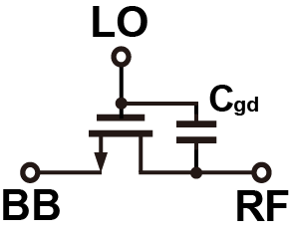
60GHz Mixer
Generally, switching mixers for RF circuits are used.
Parasitic capacitances causes large LO leakage and RF-LO isolation.
Notes:
Switching mixers is generally used in RF circuits.
But, in 60GHz, parasitic capacitance influences in mixer characteristics.
Due to the capacitance between gate and drain Cgd, LO signal leaks to RF port and RF signal leaks to LO port.
So, LO leakage and RF-LO isolation is larger in 60GHz.

Slide 6
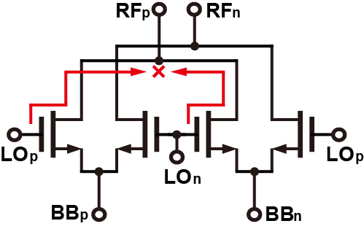
Double-balanced mixer
This topology can cancel LO signal to RF port and RF signal to LO port.
By DC and capacitance mismatch, LO leakage and RF-LO isolation is larger.
Notes:
We use double-balanced mixer to decrease LO leakage and RF-LO isolation.
As shown in this figure, by using this topology, LO leakage to RF port can be ideally canceled.
Similarly, RF leakage to LO port can be canceled.
However, in fact, there are DC and capacitance mismatch.
Then, LO leakage and RF-LO isolation can not be ideally cancelled.

Slide 7
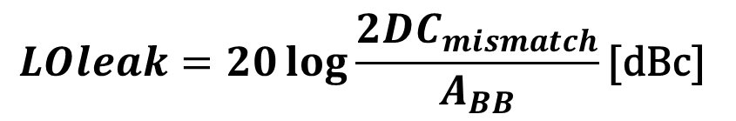
DC mismatch
$$LOleak=20\log{\frac{2{DC}_{mismatch}}{A_{BB}}}\text{[}\text{dBc}\text{]}$$
V_{th} variation causes DC mismatch.
Larger DC mismatch, Larger LO leakage.
  DC mismatch calibration
Notes:
This is LO leakage with respect to DC mismatch.
Vth variation causes DC mismatch.
This equation shows the relationship between LO leakage and DC mismatch.
ABB is input voltage amplitude.
As shown in this equation, DC mismatch is lager, LO leakage is larger.
As shown here, when DC mismatch is 1mV, LO leakage is larger as -27dBc.
The target of LO leakage is -40dBc. So, DC mismatch calibration is needed.

Slide 8
C_{gd} mismatch
Layout causes capacitance mismatch.
Larger C_{gd} mismatch, Larger LO leakage and RF-LO isolation.
  Asymmetric layout
Notes:
This is RF-LO isolation with respect to capacitance mismatch between RF and LO port.
Capacitance mismatch is larger, LO leakage and RF-LO isolation are larger.
By layout method, capacitance mismatch changes.
So, we propose asymmetric layout.

Slide 9
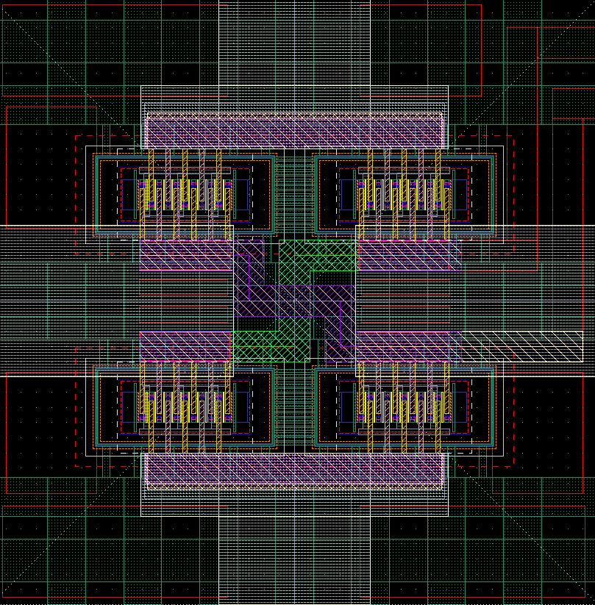
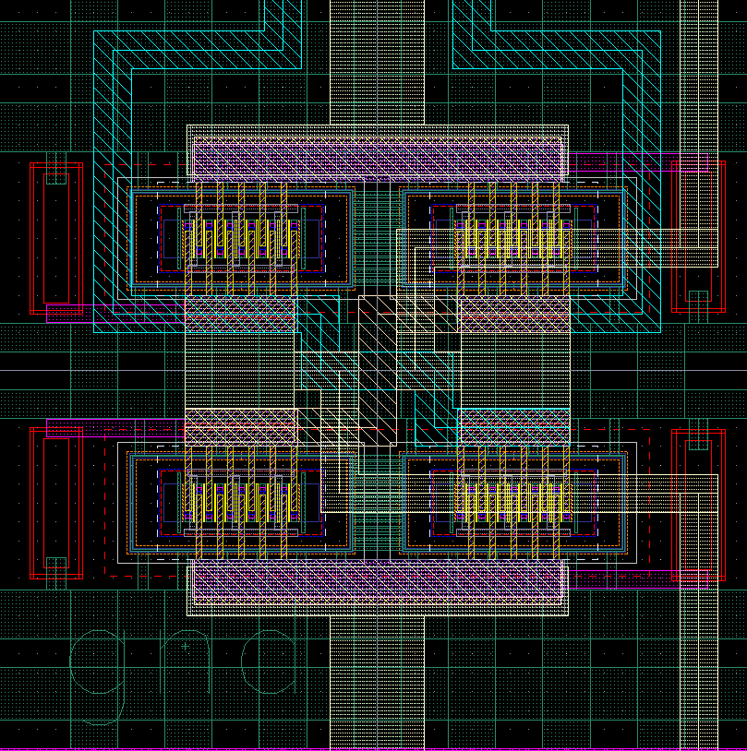
Asymmetric layout
Mixer core excluding intersection
  LO line and RF line cross in matching network
Mixer core including intersection
  bad symmetrical property
RF+
RF+
LO+
LO+
LO-
RF-
RF-
LO-
Symmetrical core
(Not Good)
Asymmetrical core
(Good)
Notes:
When we design the layout of a double balanced mixer on chip, LO signal line and RF signal line need intersection.
Because each lines should connect other differential circuit, like differential amplifiers or baluns.
These pictures show mixer core layouts.
The left layout has symmetrical core design.
It is used in our previous work..
But, in this case, an intersection is needed in matching network.
The right one has intersection in the core layout.
LO line is arranged asymmetrically.
It has some mismatch.
But no more intersection is needed for the matching network.

Slide 10
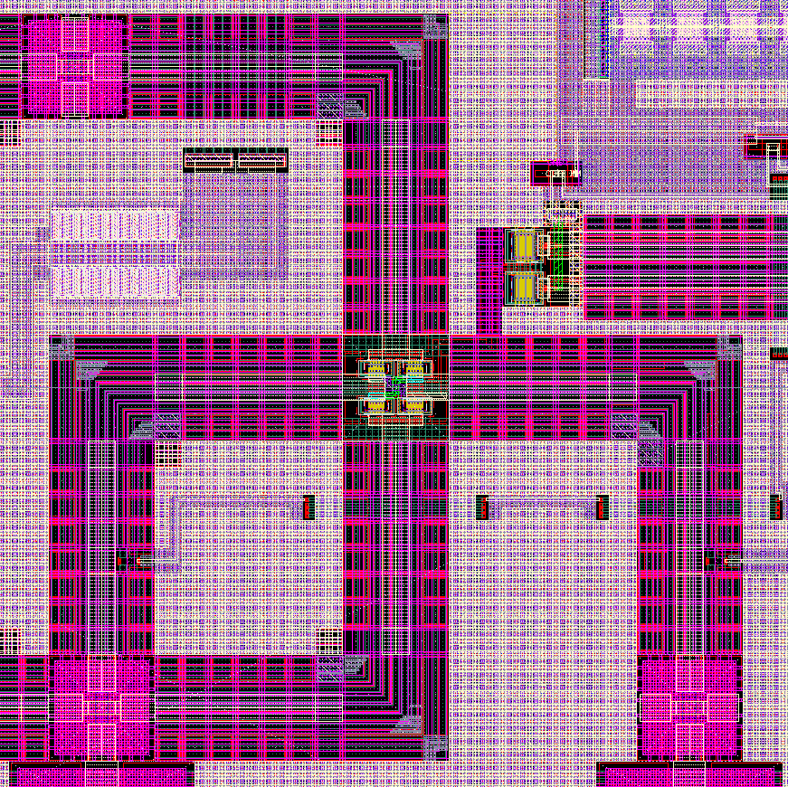
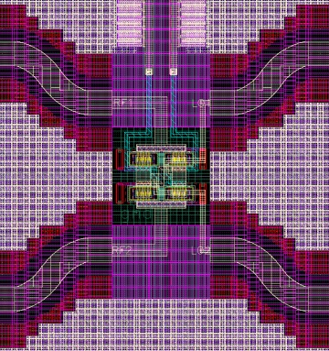
Asymmetric layout
Symmetrical core needs crossed and complicated matching network.
Asymmetrical core can realize simple matching network.
RF+
BB+ BB-
BB+
BB-
RF+
LO+
RF-
LO-
RF-
Asymmetrical core
LO+
LO-
Symmetrical core
Notes:
These picture shows mixer layout with a matching network.
The left one uses symmetrical core layout.
They are RF lines, and they are LO lines. 2 lines are crossed here..
The matching network is crossed.
This cross point increases capacitor between RF and LO port.
So, This layout causes bad symmetric property and capacitor mismatch is larger.
On the other hand, asymmetrical core can realize simple matching network.
There is no crossing point.
matching network is small, so it can realize better symmetric property and smaller capacitor mismatch.

Slide 11
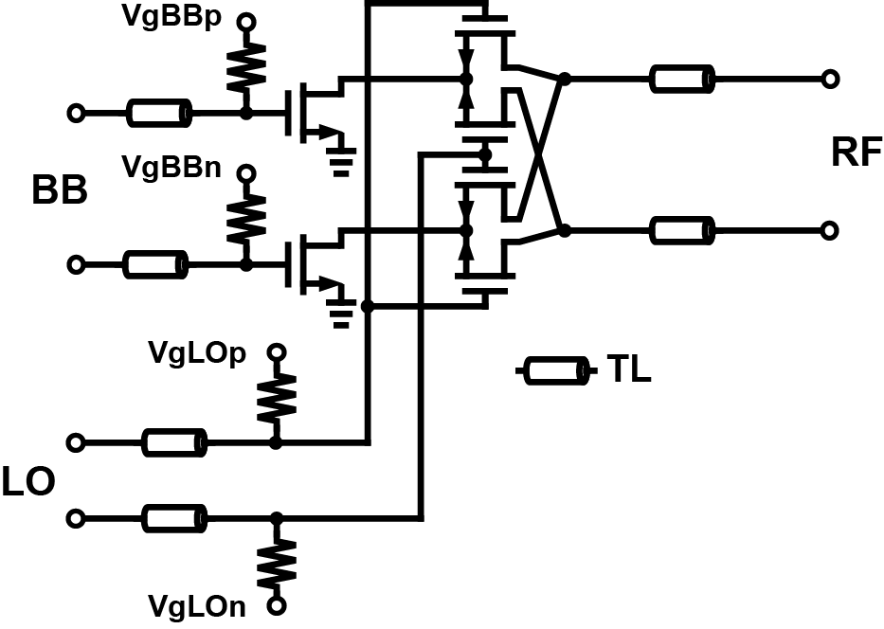
Schematic
Active mixer
  Large CG
Notes:
This is the schematic of the up-conversion mixer.
The gain of a power amplifier in 60GHz is smaller than that in a few GHz.
So, we can utilize active mixer to get large conversion gain.
Transmission lines are used for matching networks.

Slide 12
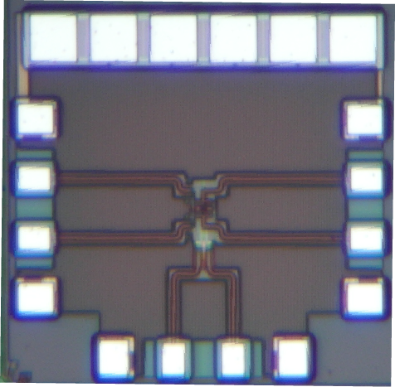
Die photo
Area of mixer core : 160×50[μm²]
Notes:
This is the microphotograph of the asymmetric mixer.
This is designed in 65nm CMOS process.
The chip area is about 0.4 mm2. But the area of mixer core is 0.008 mm2.

Slide 13
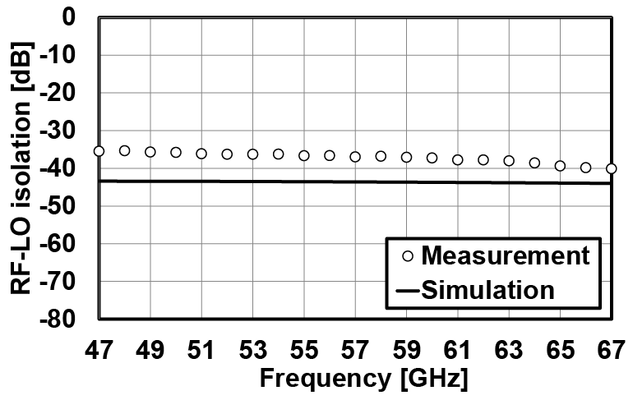
RF-LO isolation
RF-LO isolation is measured using network analyzer.
RF-LO isolation @ 60GHz : -37.3dBc
Notes:
This is RF-LO isolation.
RF-LO isolation is measured using network analyzer.
By utilizing asymmetric layout, a RF-LO isolation of -37.3dBc is achieved at 60GHz.

Slide 14
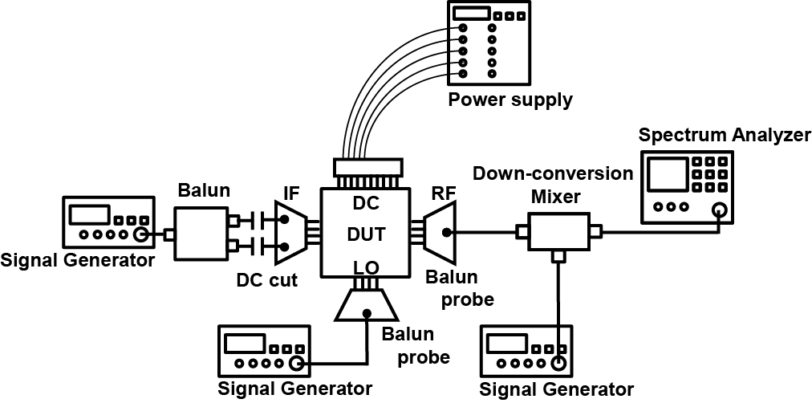
Measurement system
BB and LO input : Signal generator
RF output : Spectrum analyzer
Notes:
Conversion gain and LO leakage are measured by a measurement system as shown in this figure.
BB and LO signal are generated by signal generator.
RF signal is down-converted by a mixer because spectrum analyzer can’t observe 60GHz signal.

Slide 15
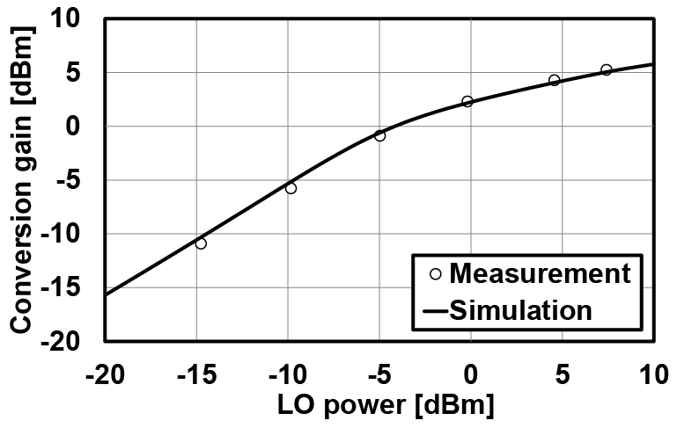
Conversion gain
BB frequency : 100MHz
LO frequency : 62.64GHz
Notes:
This is conversion gain with respect to LO power.
BB frequency is 100MHz. LO frequency is 62.64GHz.
LO frequency is based on IEEE 802.15.3c standard.
The measurement results are in good agreement with simulation results
because parasitic capacitors have little influence on mixer switching operation.

Slide 16
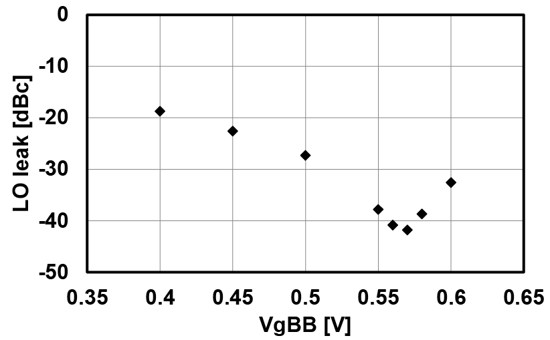
LO leakage
DC mismatch calibration
V_{gBB} on one side is fixed to 0.5V.
LO leakage : -41.1dBc
Notes:
This graph shows LO leakage.
VgBB on one side is fixed to 0.5V and another side is swept.
By this operation, DC mismatch is calibrated.
The minimum LO leakage is achieved -41.1dBc.
The influence of DC mismatch is larger than that of capacitor mismatch.
So, by using asymmetric layout, capacitor mismatch can be decreased.

Slide 17
Performance comparison
Up-conversion mixer | This work | [1] | [2]
Technology | 65nm | 130nm | 90nm
Conversion gain [dB] | 4.3 | 4.0 | 4.5
RF-LO Isolation [dB] | -37.3 | -37 | -57.5
LO leakage [dBc] | -41.1 | -30 | N/A
Power consumption [mW] | 5.4 | 24.0 | 15.1
[1] F. Zhang, et al., Electronics Letters, 2012
[2] T. Tsai, et al., Electronics Letters, 2012
Notes:
This is a performance comparison of 60GHz up-conversion mixers.
Other mixers are achieved low RF-LO isolation and LO leakage,
however the power consumption are very high.
On the other hand, our mixer has achieved low LO leakage of -41.1dBc, low RF-LO isolation of -37.3dB
and low power consumption of 5.4mW thanks to the asymmetric layout.

Slide 18
Conclusions
Up-conversion mixer using asymmetric layout is presented.
The mixer in 65nm CMOS achieved conversion gain of 4.3dB, RF-LO isolation of -37.3dB, LO leakage of -41.1dBc and power consumption of 5.4mW.
Notes:
Finally, I’ll conclude my presentation.
I present up-conversion mixer using asymmetric core layout.
The mixer is designed in 65nm CMOS and achieves a conversion gain of 4.3dB,
an RF-LO isolation of -37.3dB, a LO leakage of -41.1dBc and a power consumption of 5.4mW.
This is the end of my presentation.
Thank you for your attention.

Slide 20
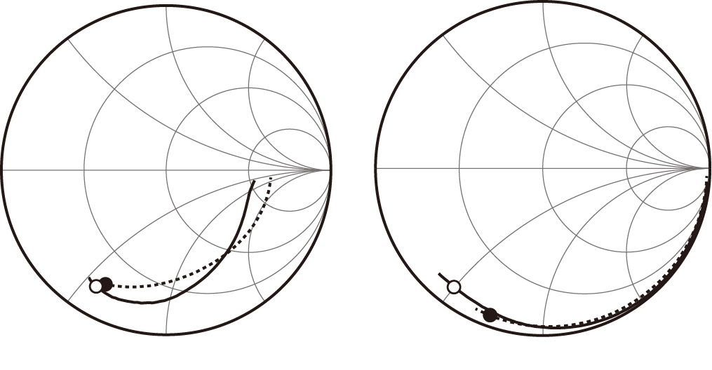
Impedance
RF port
LO port
Solid line: measurement, Dotted line: simulation
Markers show 60GHz point.
The difference between simulation and measurement is due to parasitic inductance.

Slide 21
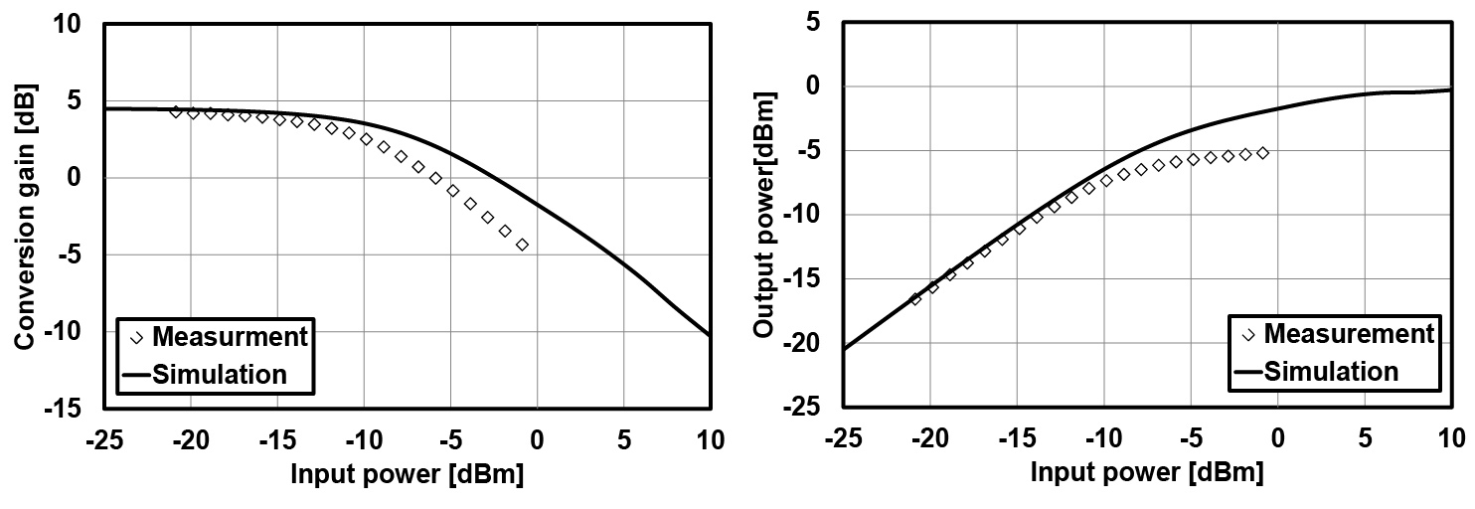
Large-signal characteristics
P_{1dB} : -8.7dBm
P_{sat} : -5.2dBm

