Slide 1
非対称レイアウトを用いた60GHz帯低LOリーク
アップコンバージョンミキサ
○佐藤 慎司, 津久井 裕基,
岡田 健一, 松澤 昭
東京工業大学大学院理工学研究科
Notes:
Thank you for the kind introduction.
I’m Yuki Tsukui from Tokyo Institute of Technology, Japan.
Today, I’d like to talk about a 60GHz up-conversion mixer using asymmetric layout with -41.1dBc LO leakage.

Slide 2
発表内容
研究背景
60GHz帯におけるミキサの課題
非対称コアレイアウトを用いたミキサ
測定結果
まとめ
Notes:
This is the outline of my presentation.
First of all, I’ll talk about a 60GHz wireless communication.
Next, I’ll talk about mixer topology and new layout method to decrease LO leakage and RF-LO isolation.
Next, I’ll talk about measurement results of the mixer using asymmetric layout.
Finally, I’ll conclude the presentation.

Slide 3
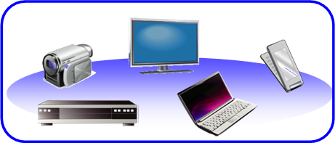
研究背景
60GHz帯の特徴
☹ 伝搬中の減衰が大きい
☺ 幅広い帯域が無免許で
開放されている
近距離高速無線通信への利用が期待される
IEEE 802.11.ad
  57.24GHz – 65.88GHz
  2.16GHz/ch x 4ch
  QPSK ⇒ 3.5Gbps/ch
  16QAM ⇒ 7.0Gbps/ch
  64QAM ⇒ 10.6Gbps/ch

Slide 4
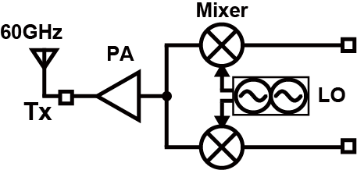
60GHz帯におけるミキサの課題
RF-LO isolation
BB
BB
LO leakage
LO リーク ⇒ EVMの劣化
RF-LO アイソレーション ⇒ プリングを引き起こす
低いLOリークとRF-LOアイソレーションが必要
Notes:
This figure shows a general 60GHz transmitter.
BB signal is modulated to RF signal by mixers and then amplified by Power amplifier.
LO leakage is the LO signal leaked from LO port to RF port as shown in this figure..
RF-LO isolation is the RF signal leaked from RF port to LO port.
When LO leakage is large, EVM is degraded.
When RF-LO isolation is small, LO frequency move. This phenomena is called pulling.
So, the object of this research is to decrease the LO leakage and RF-LO isolation.

Slide 5
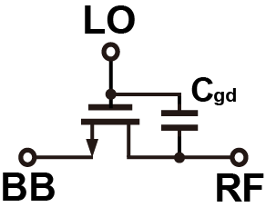
60GHz帯のミキサ
60GHz帯ではミキサのスイッチ部分において寄生容量の影響が大きく、LOリークやRF-LOアイソレーションが大きくなる
Notes:
Switching mixers is generally used in RF circuits.
But, in 60GHz, parasitic capacitance influences in mixer characteristics.
Due to the capacitance between gate and drain Cgd, LO signal leaks to RF port and RF signal leaks to LO port.
So, LO leakage and RF-LO isolation is larger in 60GHz.

Slide 6
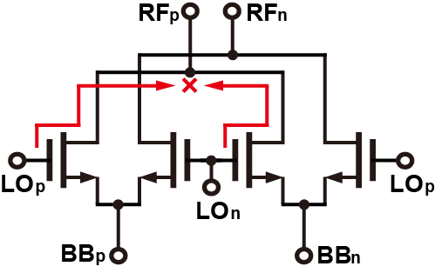
ダブルバランスドミキサ
このトポロジーではLOリークとRF-LOアイソレーションを打ち消すことができる
DCミスマッチやキャパシタンスのミスマッチがあるとLOリークとRF-LOアイソレーションを打ち消すことができない
Notes:
We use double-balanced mixer to decrease LO leakage and RF-LO isolation.
As shown in this figure, by using this topology, LO leakage to RF port can be ideally canceled.
Similarly, RF leakage to LO port can be canceled.
However, in fact, there are DC and capacitance mismatch.
Then, LO leakage and RF-LO isolation can not be ideally cancelled.

Slide 7
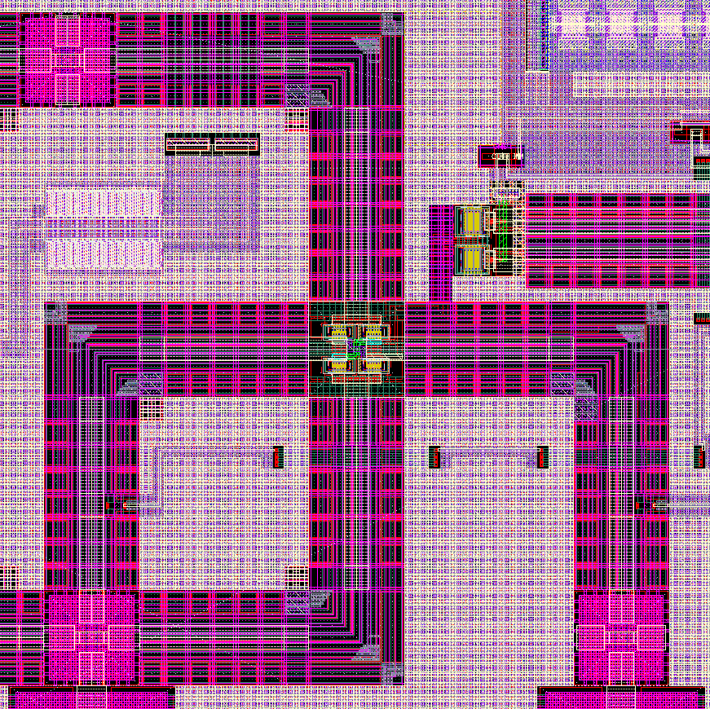
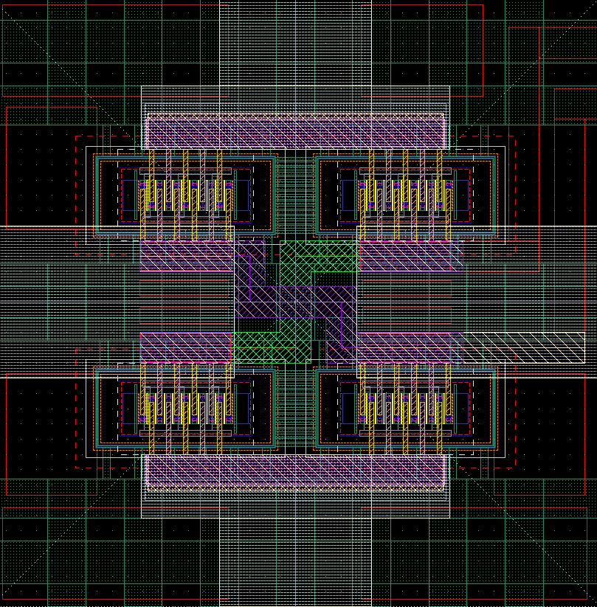
対称コアミキサのレイアウト（従来）
コア部分を対称にすると、
LOとRFの伝送線路に交差が生じる
キャパシタンスのミスマッチが大きい
RF+
RF+
BB+
BB-
LO+
LO-
RF-
RF-
LO+
LO-

Slide 8
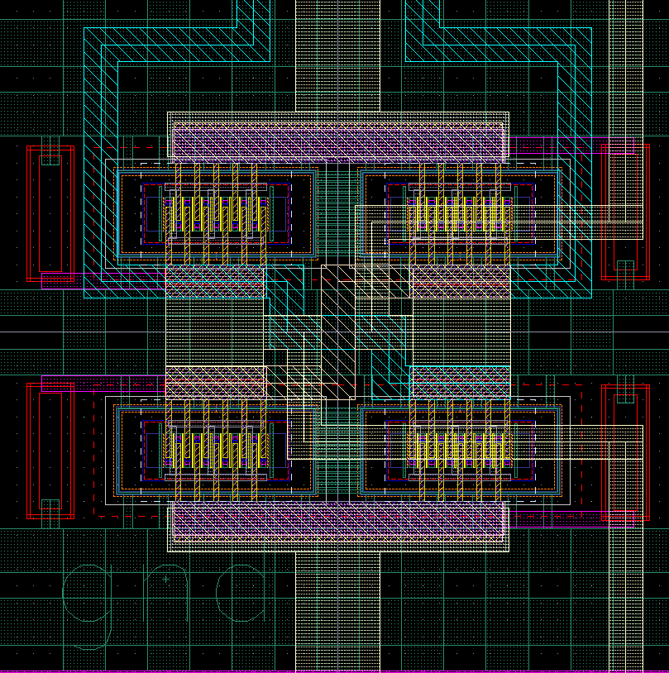
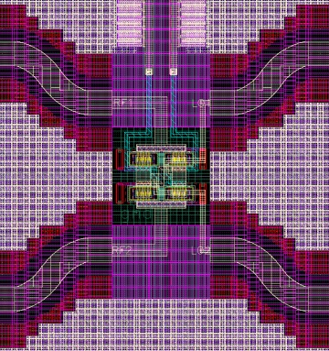
非対称コアミキサのレイアウト（提案）
コア部分を非対称にすることで、
LOとRFの伝送線路に交差が生じない
キャパシタンスのミスマッチが少ない
RF+
LO+
BB+ BB-
RF+
LO+
RF-
LO-
RF-
LO-

Slide 9
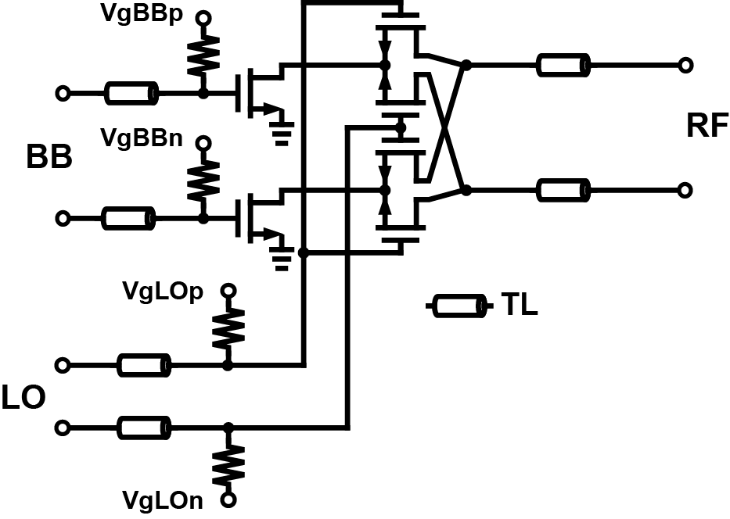
ミキサの回路図
Active mixer
  Large CG
Notes:
This is the schematic of the up-conversion mixer.
The gain of a power amplifier in 60GHz is smaller than that in a few GHz.
So, we can utilize active mixer to get large conversion gain.
Transmission lines are used for matching networks.

Slide 10
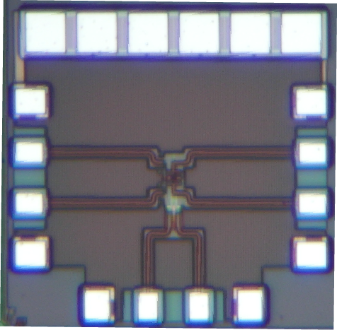
Die photo
65nm CMOSプロセス
ミキサコア面積: 160×50[μm²]
Notes:
This is the microphotograph of the asymmetric mixer.
This is designed in 65nm CMOS process.
The chip area is about 0.4 mm2. But the area of mixer core is 0.008 mm2.

Slide 11
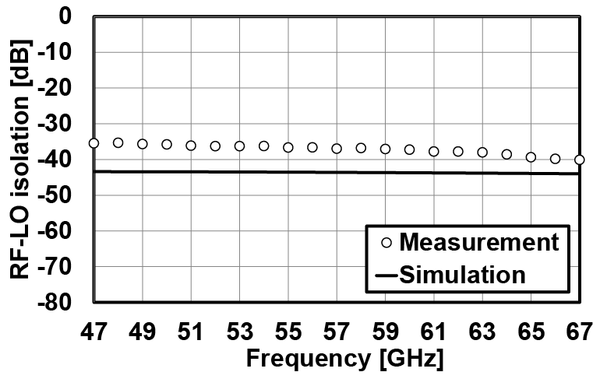
RF-LOアイソレーション
RF-LOアイソレーションはネットワークアナライザを用いて測定した
RF-LOアイソレーション@ 60GHz : -37.3dBc
Notes:
This is RF-LO isolation.
RF-LO isolation is measured using network analyzer.
By utilizing asymmetric layout, a RF-LO isolation of -37.3dBc is achieved at 60GHz.

Slide 12
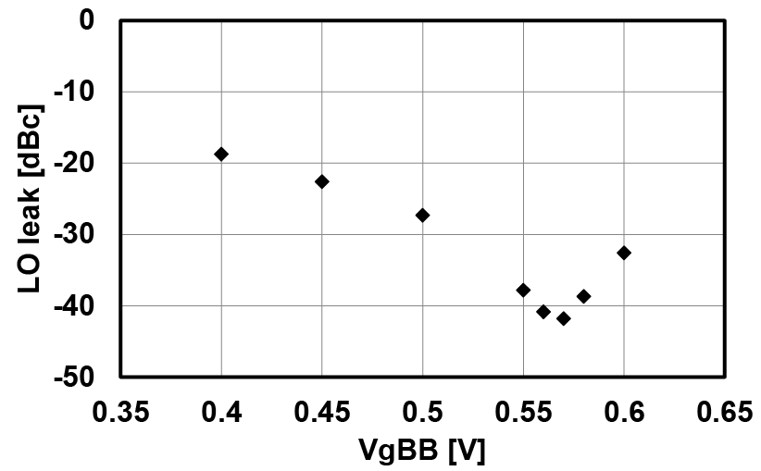
LOリーク
DCミスマッチキャリブレーションを行った
差動片側のV_{gBB}を0.5Vに固定し、もう一方のV_{gBB}スイープした。
LOリーク：-41.1dBc
対称コアレイアウト：約-20dBc
Notes:
This graph shows LO leakage.
VgBB on one side is fixed to 0.5V and another side is swept.
By this operation, DC mismatch is calibrated.
The minimum LO leakage is achieved -41.1dBc.
The influence of DC mismatch is larger than that of capacitor mismatch.
So, by using asymmetric layout, capacitor mismatch can be decreased.

Slide 13
性能比較
Up-conversion mixer | This work | [1] | [2]
Technology | 65nm | 130nm | 90nm
Conversion gain [dB] | 4.3 | 4.0 | 4.5
RF-LO Isolation [dB] | -37.3 | -37 | -57.5
LO leakage [dBc] | -41.1 | -30 | N/A
Power consumption [mW] | 5.4 | 24.0 | 15.1
[1] F. Zhang, et al., Electronics Letters, 2012
[2] T. Tsai, et al., Electronics Letters, 2012
Notes:
This is a performance comparison of 60GHz up-conversion mixers.
Other mixers are achieved low RF-LO isolation and LO leakage,
however the power consumption are very high.
On the other hand, our mixer has achieved low LO leakage of -41.1dBc, low RF-LO isolation of -37.3dB
and low power consumption of 5.4mW thanks to the asymmetric layout.

Slide 14
まとめ
非対称コアレイアウトを用いたアップコンバージョンミキサについて検討した。
65nm CMOSプロセスを用いたミキサを作製し、RF-LOアイソレーションが-37.3dBc、LOリークが-41.1dBcを達成した。
Notes:
Finally, I’ll conclude my presentation.
I present up-conversion mixer using asymmetric core layout.
The mixer is designed in 65nm CMOS and achieves a conversion gain of 4.3dB,
an RF-LO isolation of -37.3dB, a LO leakage of -41.1dBc and a power consumption of 5.4mW.
This is the end of my presentation.
Thank you for your attention.

Slide 15
Thank you for your attention!

Slide 17
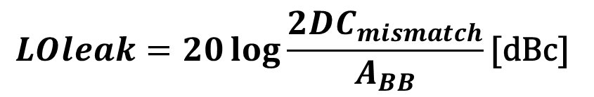
DC mismatch
$$LOleak=20\log{\frac{2{DC}_{mismatch}}{A_{BB}}}\text{[}\text{dBc}\text{]}$$
V_{th} variation causes DC mismatch.
Larger DC mismatch, Larger LO leakage.
  DC mismatch calibration
Notes:
This is LO leakage with respect to DC mismatch.
Vth variation causes DC mismatch.
This equation shows the relationship between LO leakage and DC mismatch.
ABB is input voltage amplitude.
As shown in this equation, DC mismatch is lager, LO leakage is larger.
As shown here, when DC mismatch is 1mV, LO leakage is larger as -27dBc.
The target of LO leakage is -40dBc. So, DC mismatch calibration is needed.

Slide 18
C_{gd} mismatch
Layout causes capacitance mismatch.
Larger C_{gd} mismatch, Larger LO leakage and RF-LO isolation.
  Asymmetric layout
Notes:
This is RF-LO isolation with respect to capacitance mismatch between RF and LO port.
Capacitance mismatch is larger, LO leakage and RF-LO isolation are larger.
By layout method, capacitance mismatch changes.
So, we propose asymmetric layout.

Slide 19
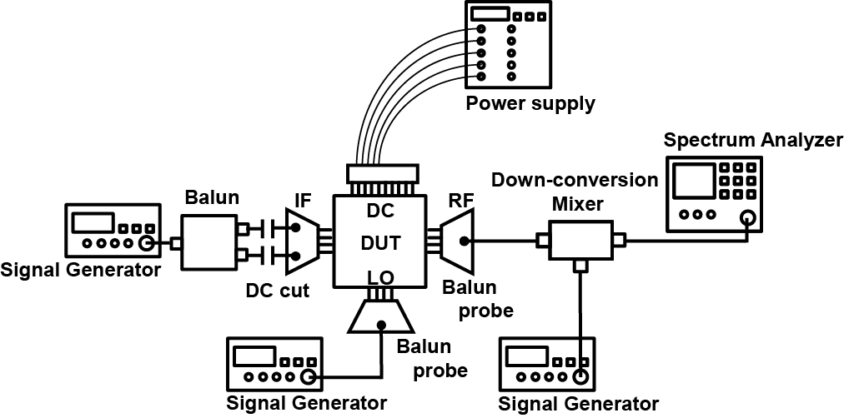
Measurement system
BB and LO input : Signal generator
RF output : Spectrum analyzer
Notes:
Conversion gain and LO leakage are measured by a measurement system as shown in this figure.
BB and LO signal are generated by signal generator.
RF signal is down-converted by a mixer because spectrum analyzer can’t observe 60GHz signal.

Slide 20
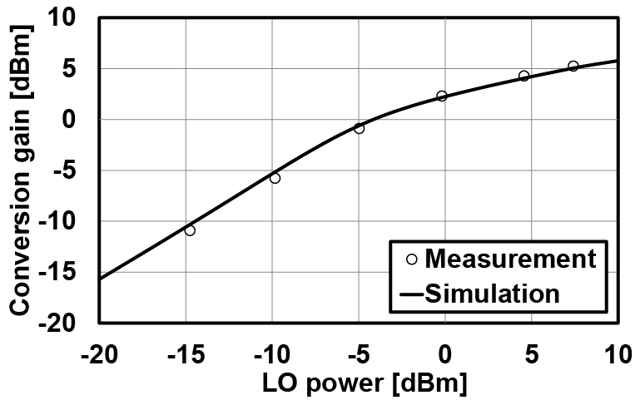
Conversion gain
BB frequency : 100MHz
LO frequency : 62.64GHz
Notes:
This is conversion gain with respect to LO power.
BB frequency is 100MHz. LO frequency is 62.64GHz.
LO frequency is based on IEEE 802.15.3c standard.
The measurement results are in good agreement with simulation results
because parasitic capacitors have little influence on mixer switching operation.

Slide 21
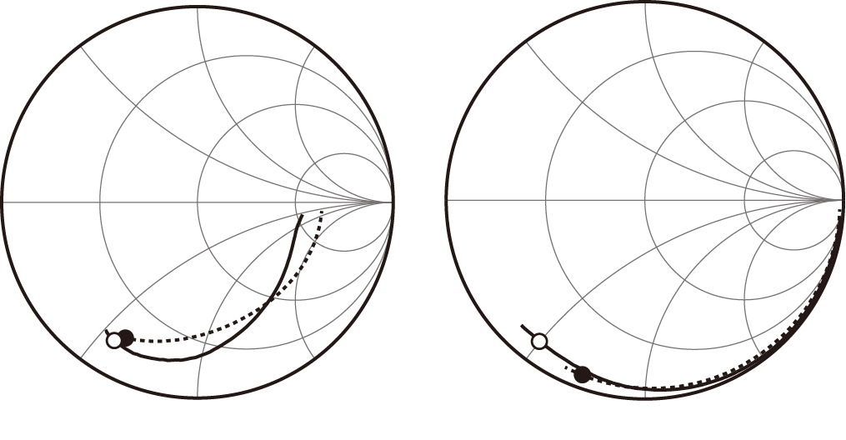
Impedance
RF port
LO port
Solid line: measurement, Dotted line: simulation
Markers show 60GHz point.
The difference between simulation and measurement is due to parasitic inductance.

Slide 22
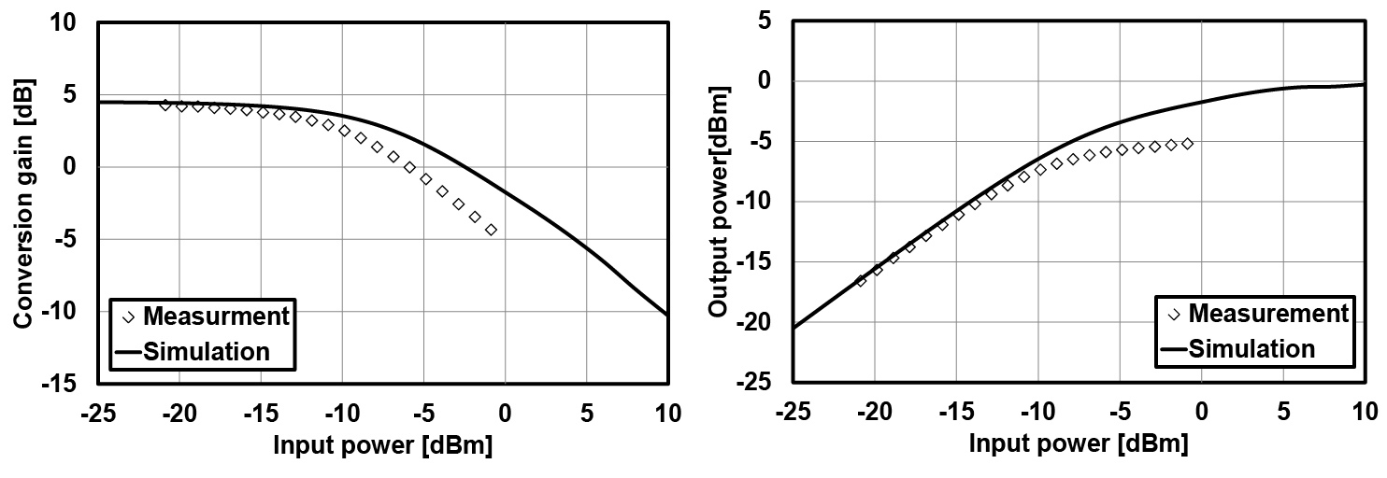
Large-signal characteristics
P_{1dB} : -8.7dBm
P_{sat} : -5.2dBm

