Slide 1

A Dual-Loop Injection-Locked PLL with All-Digital PVT Calibration System
Wei Deng, Ahmed Musa, Teerachot Siriburanon, Masaya Miyahara, Kenichi Okada, and Akira Matsuzawa
Tokyo Institute of Technology, Japan
Notes:
2007/10/29
1

Slide 2
Outline
Introduction
Issues of Conventional Injection-Locked PLLs (IL-PLLs)
Proposed Dual-loop IL-PLL
    PVT Tracking Capability by Replica Loop
    Low Jitter by Main Loop
Measurement Results
Conclusion

Slide 3
Introduction
Why High Performance PLL
  Clock generation/distribution
Key Specifications for SoC Clocking
  Small area
  Low power consumption
  Low jitter
  Scalable with technology advancement
  Insensitive over environment variations

Slide 4
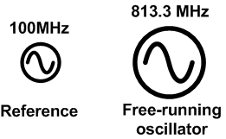
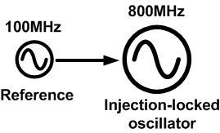
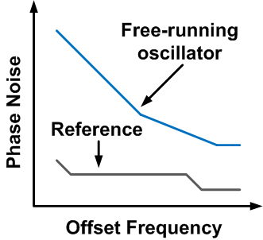
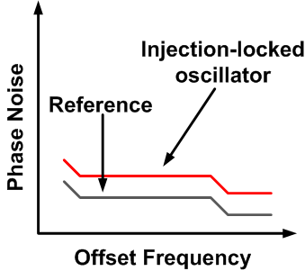
Injection-locking Technique

Slide 5
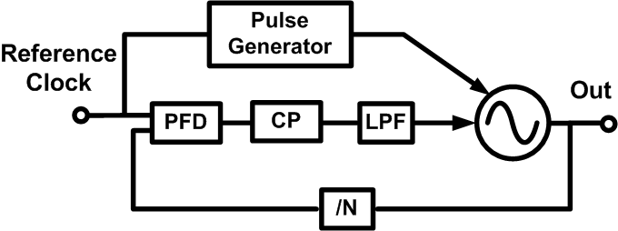
Injection-locked PLL
[J. Lee, et al., JSSC 2009]
Reference is injected into VCO through the pulse generator

Slide 6
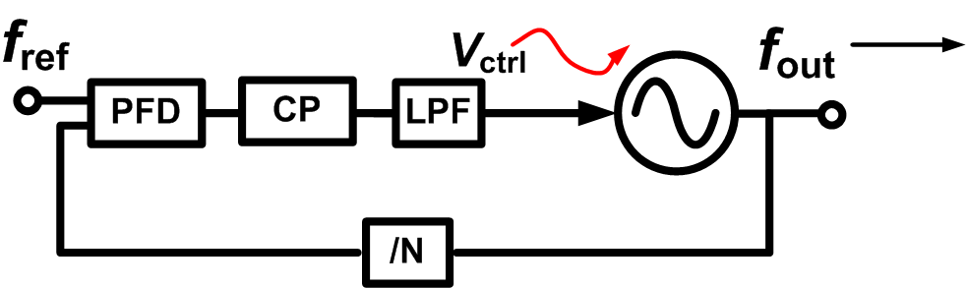
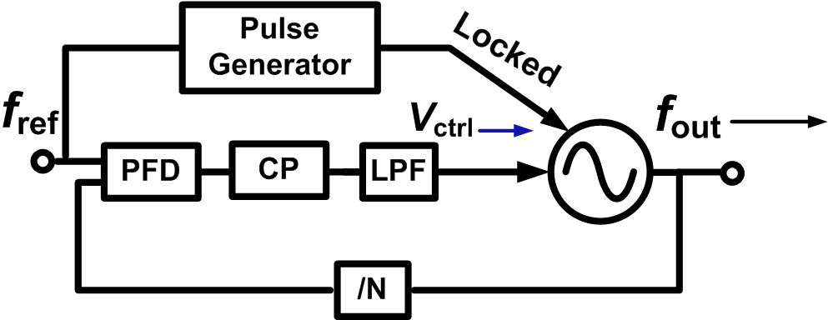
Issue of Injection-locked PLL
Can track frequency drift
Conventional PLL
Cannot track frequency drift
Conventional IL-PLL

Slide 7
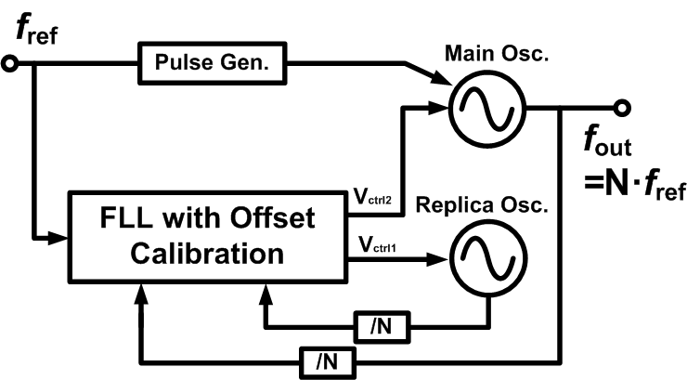
Proposed Dual-loop Architecture

Slide 8
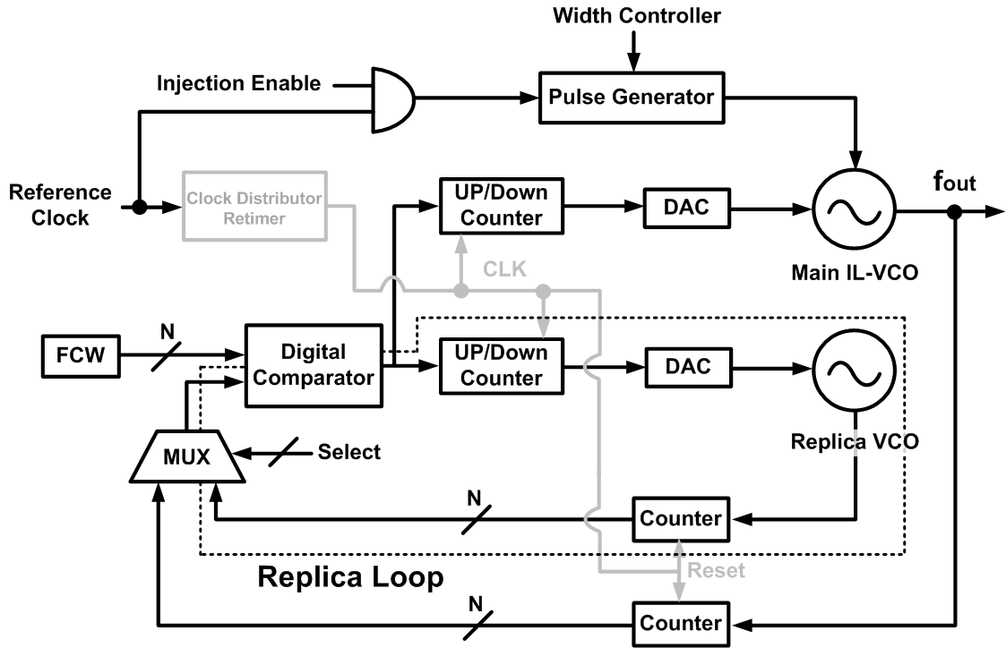
Proposed Dual-loop IL-PLL
FCW: Frequency Control Word

Slide 9
Calibration Algorithm

Slide 10
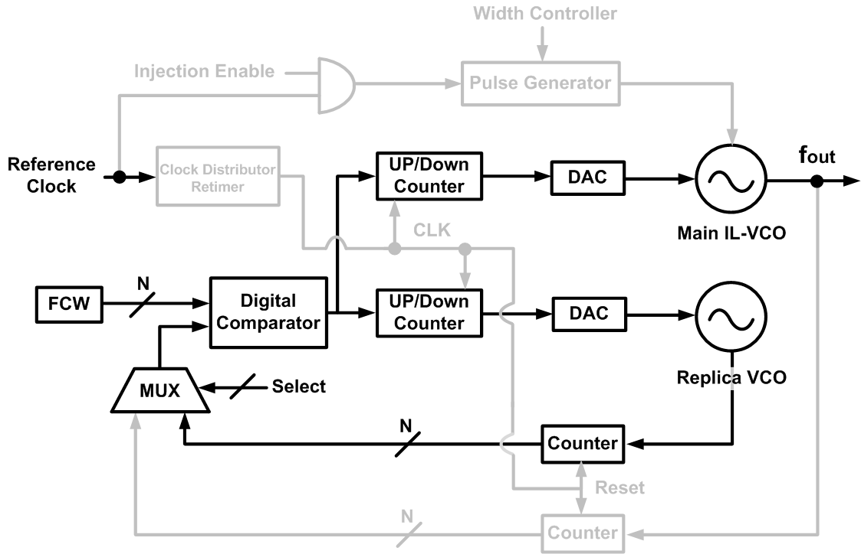
Phase I: Coarse Freq. Calibration

Slide 11
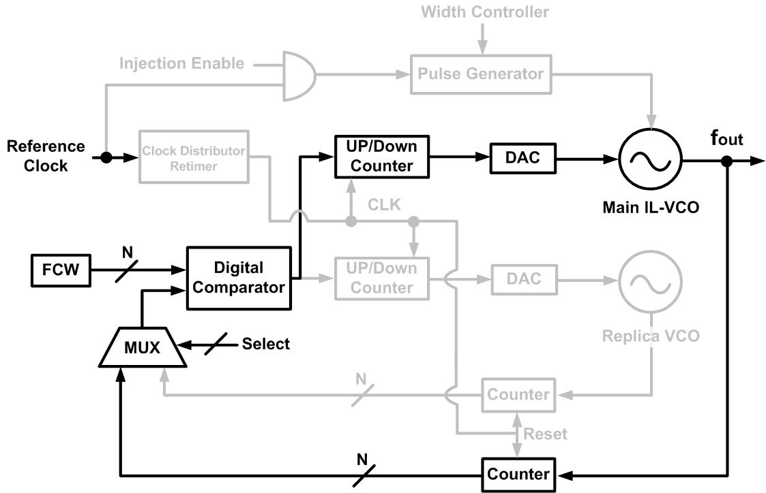
Phase II: Freq. Offset Calibration

Slide 12
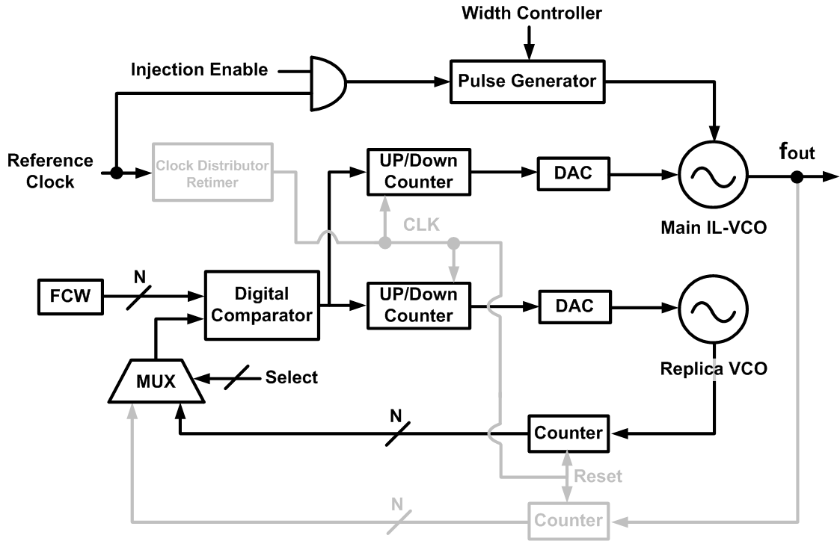
Phase III: Maintaining Operation

Slide 13
Injection-locked Ring Oscillator

Slide 14
Chip Microphotograph
Fabricated in CMOS 65nm technology

Slide 15
Phase Noise
Ref.: 300MHz (40MHz-300MHz) Freq.: 1.2GHz (0.5-1.6GHz)
Integrated jitter: 0.7ps (10kHz-40MHz) Pdc: 0.97mW (1.2GHz)

Slide 16
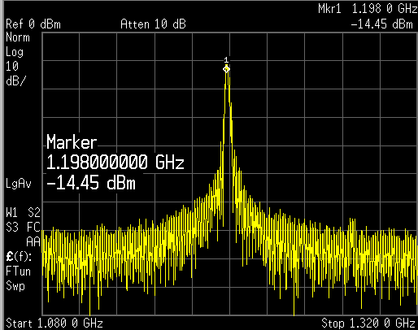
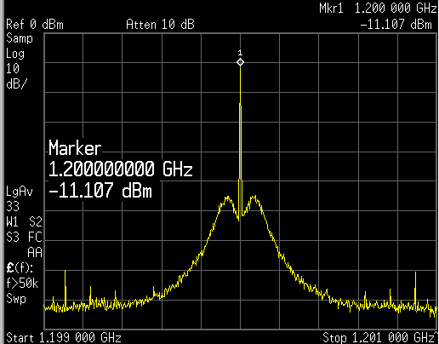
Measured Spectrum
Free-running
Locked
1.08GHz
1.32GHz
1.199GHz
1.201GHz

Slide 17
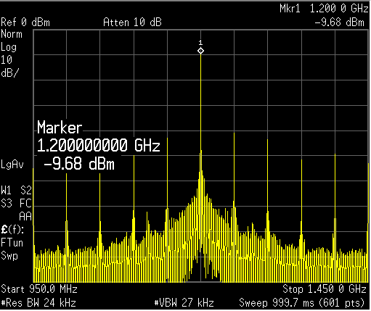
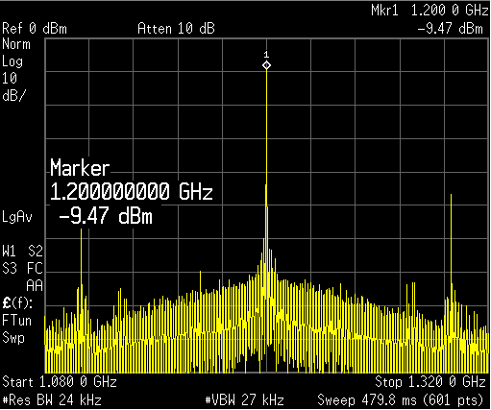
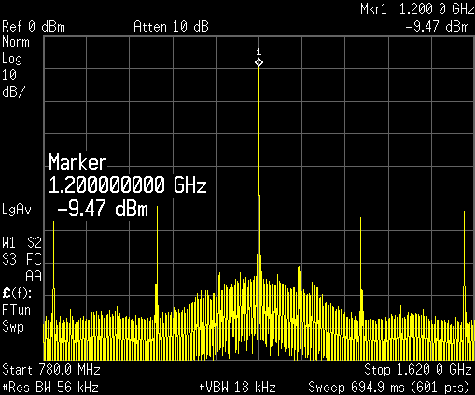
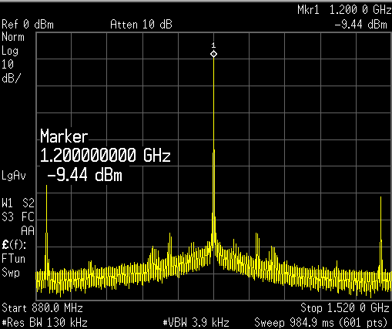
Spurious at 1.2GHz (Worst Case)
N=24
N=12
Spurious: -31 dBc
Spurious: -38 dBc
N=6
N=4
Spurious: -43 dBc
Spurious: -49 dBc

Slide 18
Measured Jitter over Temp.
Single loop
Dual loop

Slide 19
Performance Summary
 | This work | [1] |  | [2] | [5]
 | IL-PLL | DMDLL | DPLL | MDLL | IL-PLL
Freq. [GHz] | 1.2 (0.5-1.6) | 1.5 (0.8-1.8) | 1.5 (0.8-1.8) | 1.6 | 0.216
Ref. [MHz] | 300 (40-300) | 375 | 375 | 50 | 27
Power [mW] | 0.97 | 0.89 | 1.35 | 12 | 6.9
Area [mm²] | 0.022 | 0.25 | 0.25 | 0.058 | 0.03
Integ. Jitter [ps] | 0.7 | 0.4 | 3.2 | 0.68 | 2.4
Jitter RMS/PP [ps] | 1.81/19.4 10M hits | 0.92/9.2 5M hits | 4.2/33 5M hits | 0.93/11.1 30M hits | N.A.
FOM [dB] | -243 | -248.46 | -228.59 | -233.76 | -225
CMOS Tech. | 65nm | 130nm | 130nm | 130nm | 55nm
[1] A. Elshazly, et al., ISSCC 2012 [2] B. Helal, et al., JSSC 2008 [5] C. Liang, et al., ISSCC 2011

Slide 20
Conclusion
Dual-loop IL-PLL is suited for SoC clocking
  Low jitter
  Low power consumption
  Small chip area
  Scalability with process
  Insensitivity over PVT
Injection
locking
All-Digital
FLL
Dual-loop

Slide 21
Acknowledgement
This work was partially supported by SCOPE, STARC, NEDO, MIC, MEXT, Canon Foundation, Huawei, and VDEC in collaboration with Cadence Design Systems, Inc., and Agilent Technologies Japan, Ltd.

Slide 23
Intermit.Calib. at Phase III (1/2)
Step 1: Enable calibration & Replica VCO
Step 2: Disable calibration & Replica VCO
1 |  |  |  | 2 |  |  |  | 1 |  |  |  | 2 |  |  |  | 1 |  |  |  | 2
10us
990us

Slide 24
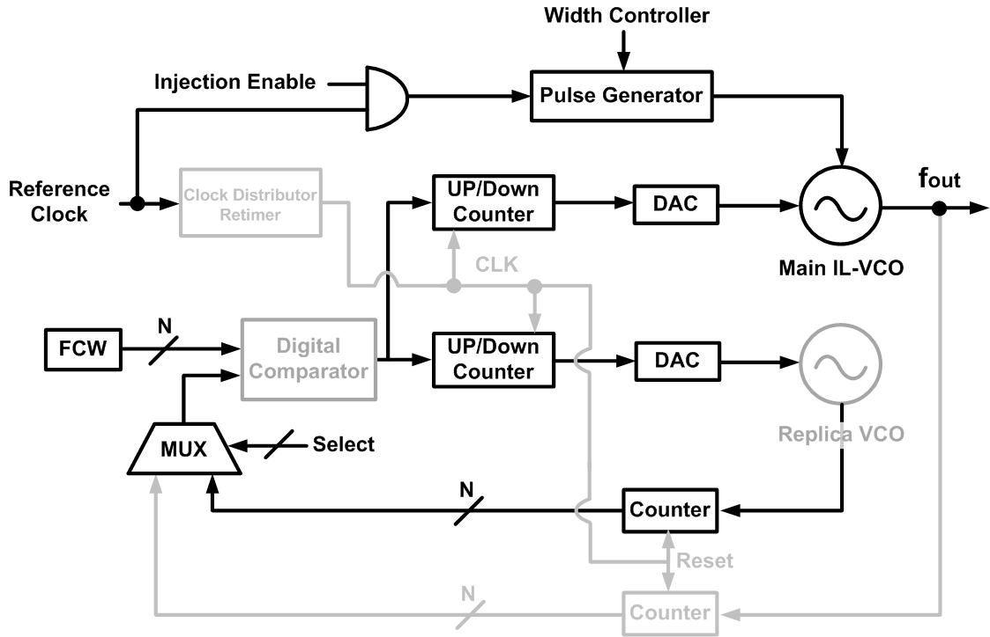
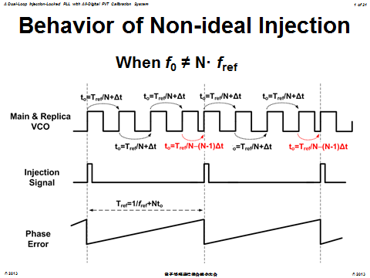
Intermit. Calib. at Phase III (2/2)
Step 1: Enable calibration & Replica VCO
W/O Intermittent | 1.6mW
W/ Intermittent | 1mW
Step 2: Disable calibration & Replica VCO
1 |  |  |  | 2 |  |  |  | 1 |  |  |  | 2 |  |  |  | 1 |  |  |  | 2
10us
990us

Slide 25
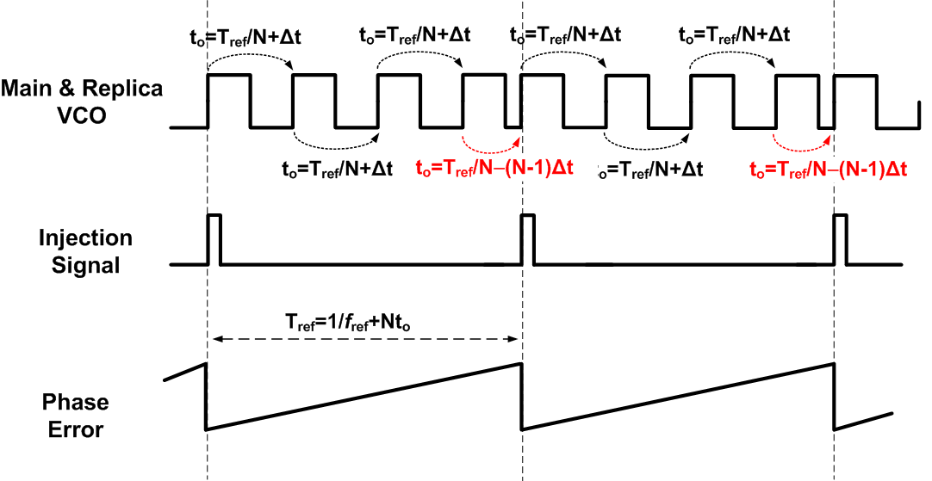
Behavior of Non-ideal Injection
When f₀ ≠ N· f_{ref}

Slide 26
Spur Level
Locked state: f_{locked}=N · f_{ref}
Free-running: f_{free-running}=(1+a) · f_{locked}
Spur power
= -20log10((f_{free-running}- f_{locked})/(2 ·f_{ref}))
= -20log10(a ·N/2)
e.g. N=20, a=0.001 ➔ -60dBc spur
[R.B. Staszewski, et al., All-Digital Frequency Synthesizer in Deep-Submicron CMOS, Wiley, 2006]

Slide 27
FOM over Area
FOM=$10\log\left[{\left(\frac{σ_{t}}{1s}\right)}^{2}·\frac{P_{DC}}{1mW}\right]$, where $σ_{t}$ is the integrating jitter
[1] A. Elshazly, et al., ISSCC 2012 [2] B. Helal, et al., JSSC 2008 [3] J. Lee, et al., JSSC 2009
[4] G. Xiang, et al., ISSCC 2009 [5] C. Liang, et al., ISSCC 2011

Slide 28
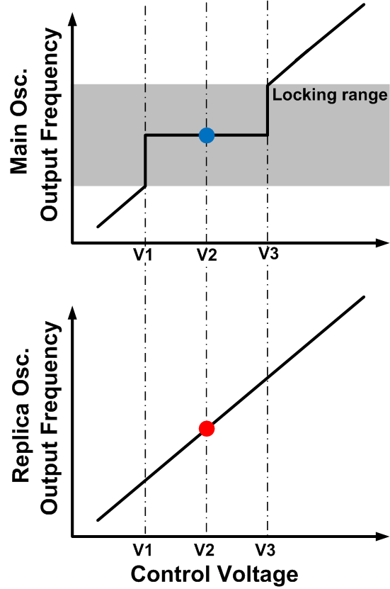
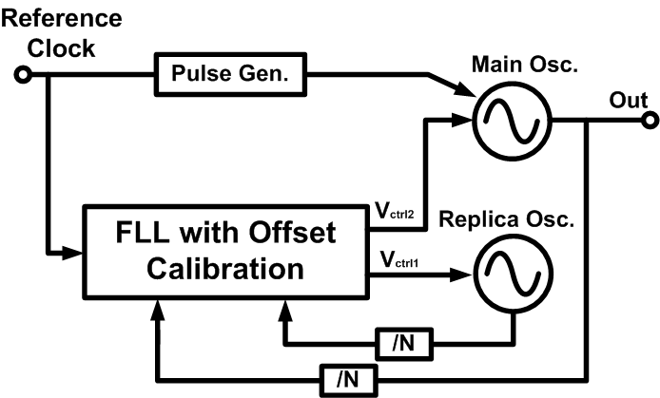
PVT Tracking Capability

Slide 29
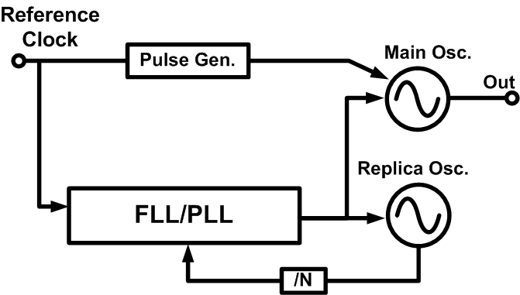
IL-PLL with Dual VCOs
Frequency offset between main & replica oscillator

Slide 30
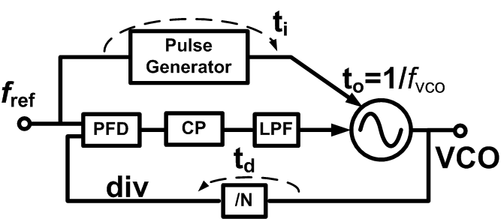
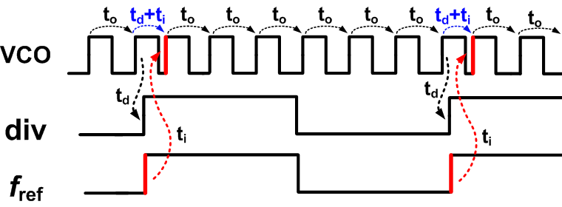
Injection Timing (Conventional)
[D. Park, et al., ISSCC 2012]

Slide 31
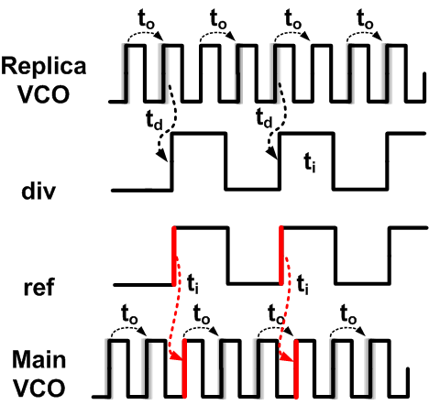
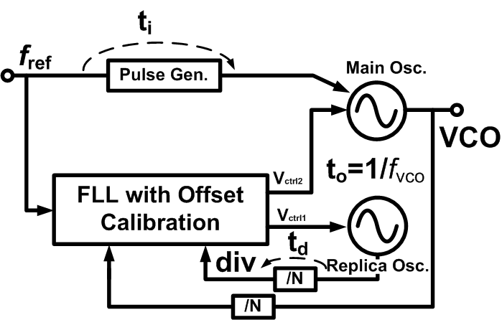
Injection Timing (Proposed)
☺
Injection timing calibration is obliterated

Slide 32
Proposed Concept
Dual-loop Topology
  PVT tracking capability
  Compensate for main & replica VCO frequency offset
  No calibration for injection timing required
    Reduce area & power overhead
All-digital Frequency-locked Loop
  Compact chip area
  Low power consumption
  Scalable with process advancement

